Slide 1



IPL AUCTION
Developing auction strategy for new IPL franchise by analyzing past IPL data to create a strong and balanced squad
Created by:
Pratik Shukla
5th May 2024

Slide 2
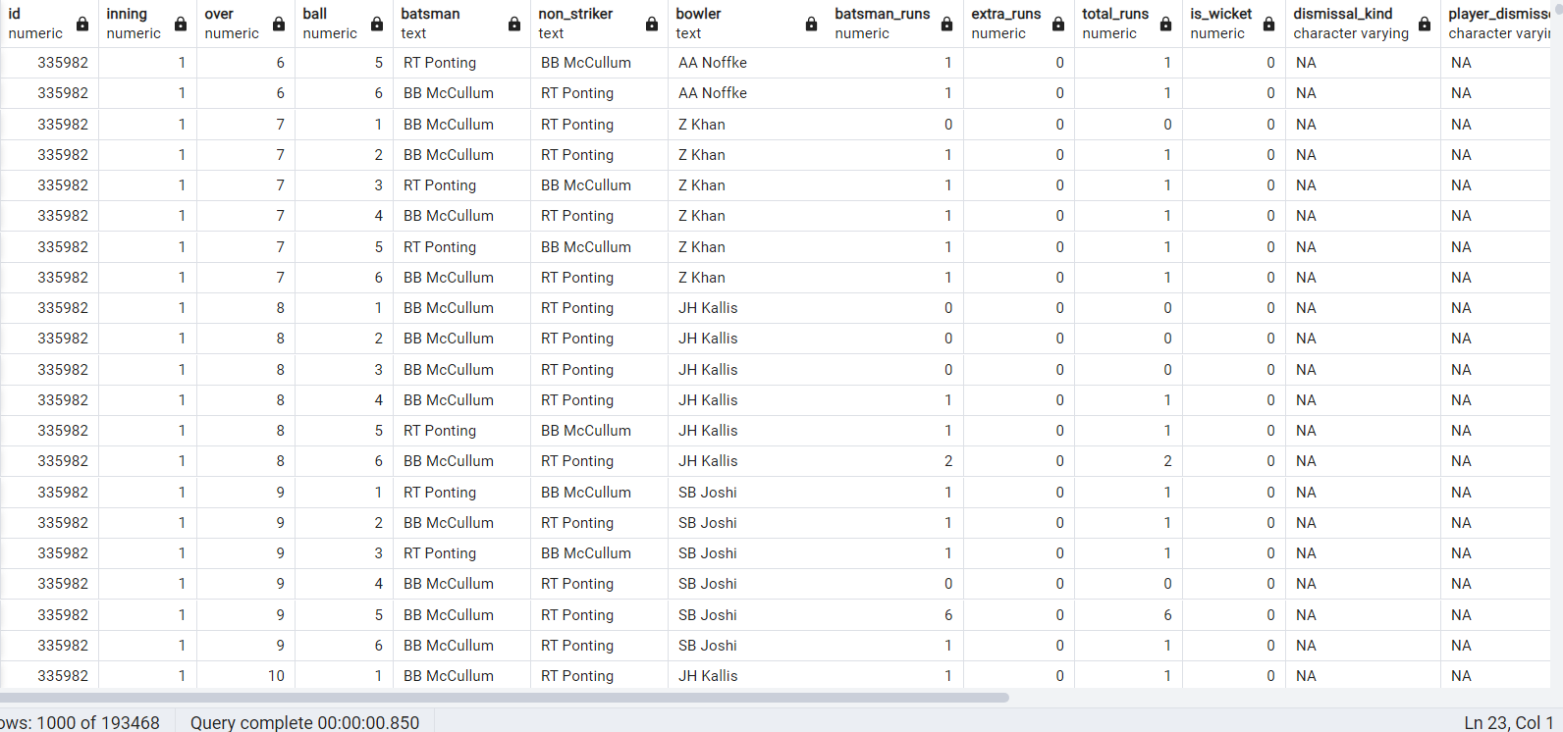
IMPORTING DATASETS
create table ipl_ball (id numeric,
inning numeric,
over numeric,
ball numeric,
batsman text,
non_striker text,
bowler text,
batsman_runs numeric,
extra_runs numeric,
total_runs numeric,
is_wicket numeric,
dismissal_kind varchar,
player_dismissed varchar,
fielder varchar,
extras_type varchar,
batting_team varchar,
bowling_team varchar
);
copy ipl_ball from 'C:\Program Files\PostgreSQL\16\IPL Dataset\IPL Dataset\IPL_Ball.csv' delimiter ',' csv header;

Slide 3
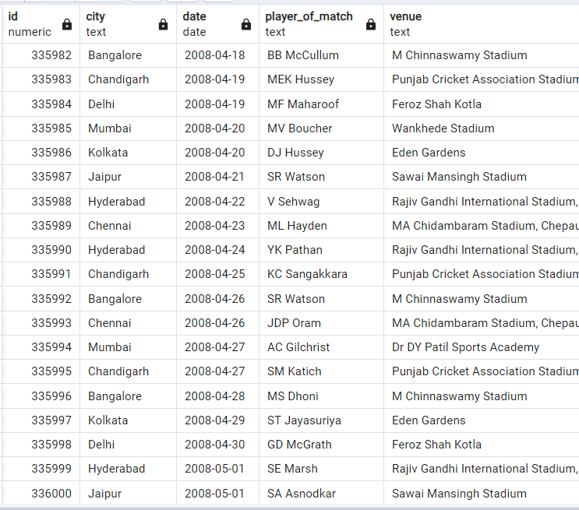
IMPORTING DATASETS
create table ipl_matches (id numeric,
city text,
date date,
player_of_match text,
venue text,
neutral_venuenumeric,
team1 varchar,
team2 varchar,
toss_winner varchar,
toss_decision varchar,
winner varchar,
result varchar,
result_margin numeric,
eliminator text,
method varchar,
umpire1 text,
umpire2 text
);
copy ipl_matches from 'C:\Program Files\PostgreSQL\16\IPL Dataset\IPL Dataset\IPL_matches.csv' delimiter ',’ csv header;

Slide 4
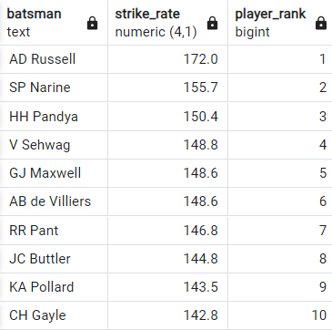
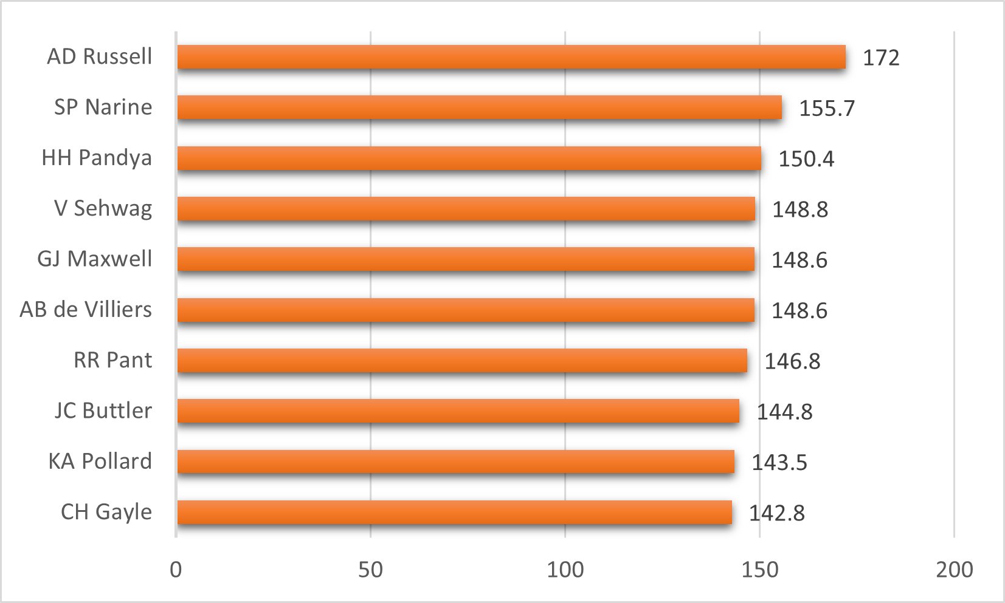
Q1
Our first priority is to get 2-3 players with high Strike Rate who have faced at least 500 balls and to do that we have to make a list of 10 players we want to bid in the auction.
select batsman, cast(strike_rate as decimal(4,1)),
dense_rank() over (order by strike_rate desc) as player_rank from(
select batsman, cast(player_total_runs as float)/balls_faced*100 as strike_rate
from (select batsman,sum(batsman_runs) as player_total_runs, count(ball) as balls_faced from ipl_ball group by batsman) as a where balls_faced>500) as b order by strike_rate desc limit 10;

Slide 5
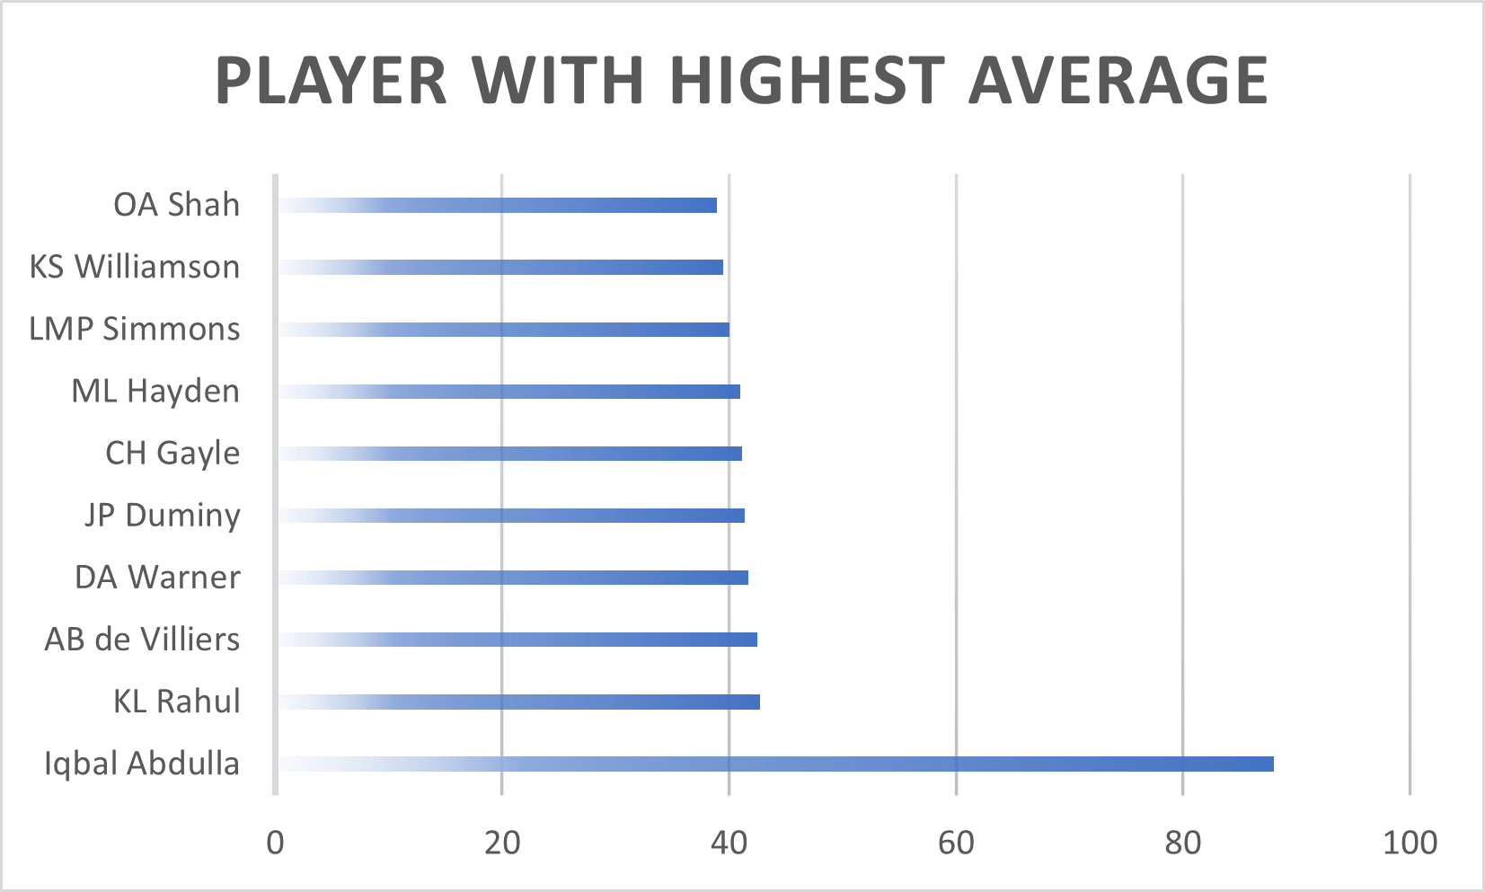
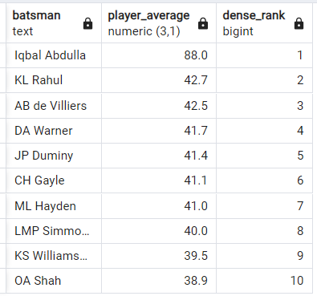
Q2
We need to get 2-3 players with good Average who have played more the 2 ipl seasons and to do that we have to make a list of 10 players.
select batsman, player_average, dense_rank() over (order by player_average desc)
from (select *, cast(avg(total_runs/dismissed_no) as decimal(3,1)) as player_average
from (select batsman, sum(batsman_runs) as total_runs, sum(is_wicket) as dismissed_no,
count(distinct extract(year from date)) as played_years
from (select a.batsman, a.batsman_runs, a.is_wicket, b.date
from ipl_ball as a
full join ipl_matches as b on a.id = b.id) as c
group by batsman) as d
group by batsman, total_runs, dismissed_no, played_years
having dismissed_no >= 1 and played_years > 2
order by player_average desc) as e limit 10;

Slide 6
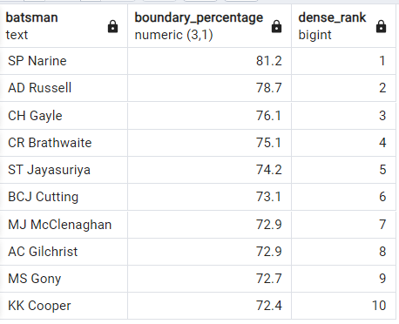
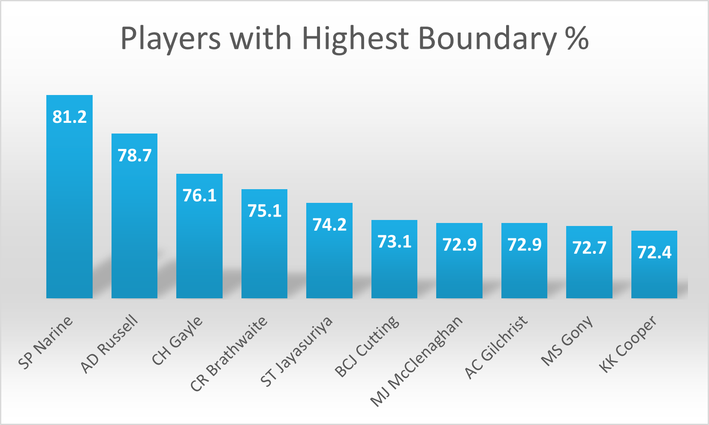
Q3
Now we need to get 2-3 Hard-hitting players who have scored most runs in boundaries and have played more the 2 ipl season.
SELECT batsman, cast(boundary_percentage AS decimal(3,1)),DENSE_RANK() OVER (ORDER BY boundary_percentage DESC)
FROM( SELECT *, (CAST (boundary_runs AS float) / total_runs*100) AS boundary_percentage FROM ( SELECT batsman,total_runs, SUM(batsman_runs) AS boundary_runs, COUNT(batsman_runs) AS boundaries_total, count(distinct extract(YEAR FROM date)) AS played_years from (SELECT a.batsman,a.batsman_runs, SUM(a.batsman_runs)OVER (PARTITION BY a.batsman) AS total_runs,
b.date FROM ipl_ball AS a FULL JOIN ipl_matches AS b ON a.id=b.id ) AS c WHERE batsman_runs=4 OR batsman_runs=6 GROUP BY total_runs, batsman ORDER BY boundaries_total DESC ) AS d WHERE played_years>2 ORDER BY boundary_percentage DESC ) AS e LIMIT 10 ;
5

Slide 7
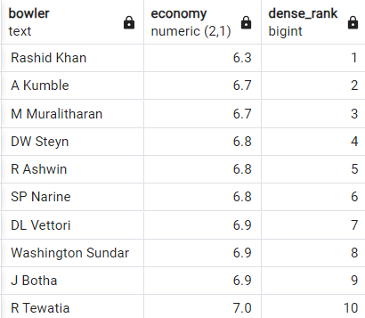
Q4
Now our first priority is to get 2-3 bowlers with good economy who have bowled at least 500 balls in IPL so far, for that we will have to look at top 10 first.
select bowler, cast(economy as decimal(2,1)), dense_rank() over (order by economy asc)
from (select *, conceded_runs / cast (bowled_overs as decimal) as economy
from (select bowler, conceded_runs, bowled_balls, count(ball) / 6 | | ‘.’ || count(ball) % 6 as bowled_overs
from (select bowler, ball, sum(total_runs) over (partition by bowler) as conceded_runs, count(ball) over (partition by bowler) as bowled_balls, over from ipl_ball ) as a
where bowled_balls > 500 group by bowler, conceded_runs, bowled_balls) as b ) as c limit 10;

Slide 8

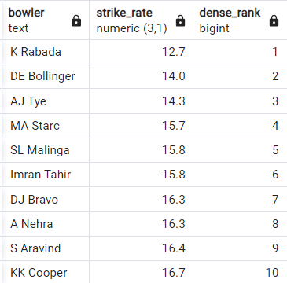
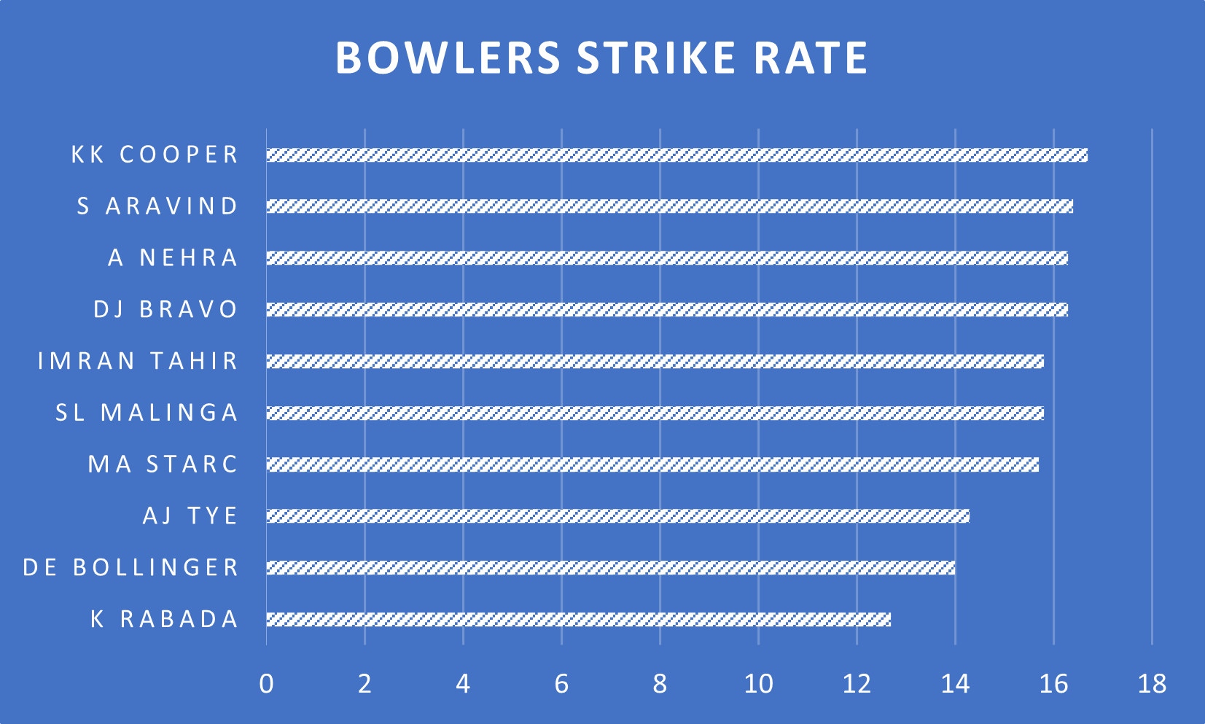
Q5.
We are looking for 2-3 bowlers with the best strike rate and who have bowled at least 500 balls in IPL so far.
select bowler, cast(strike_rate as decimal(3,1)), dense_rank() over (order by strike_rate)
from (select *, cast(total_balls as float) / wicket_taken as strike_rate
from (select bowler, total_balls, sum(is_wicket) as wicket_taken
from (select bowler, is_wicket, count(ball) over (partition by bowler) as total_balls
from ipl_ball) as a where is_wicket > 0 and total_balls > 500
group by bowler, total_balls) as b order by strike_rate asc limit 10) as c;

Slide 9
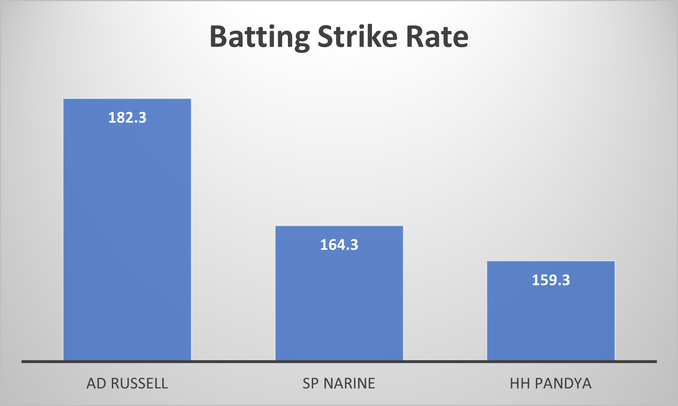
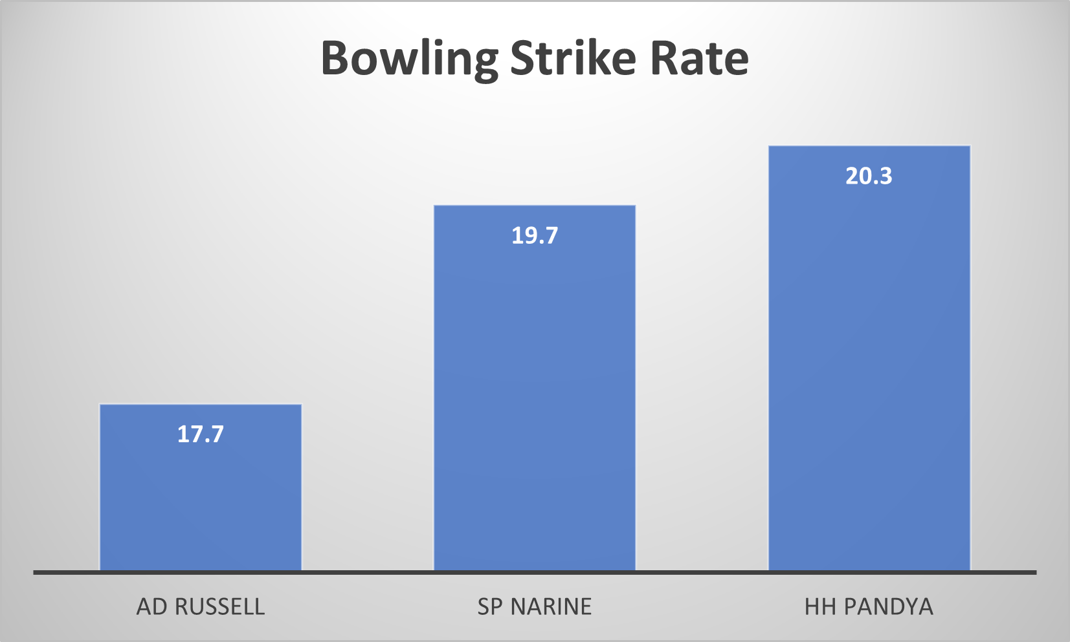
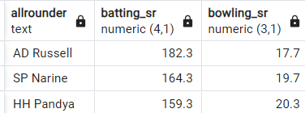
Q6
Now we are looking for 2-3 all_rounders with the best batting as well as bowling strike rate and who have faced at least 500 balls in IPL so far and have bowled minimum 300 balls.
create table bats_sr as (select batsman,cast(player_total_runs as decimal)/balls_faced*100 as batting_sr
from( SELECT batsman,sum(batsman_runs) AS player_total_runs, count(ball) AS balls_faced
FROM ipl_ball WHERE NOT extras_type ='wides' GROUP BY batsman having count(ball)>500 ) as a)
create table bowl_sr as (select bowler,cast(total_balls as decimal)/wicket_taken as bowling_sr
from( select bowler,total_balls,sum(is_wicket) as wicket_taken
from ( select bowler,is_wicket,count(ball) over (partition by bowler) as total_balls from ipl_ball ) as a
where is_wicket>0 and total_balls>300 group by bowler,total_balls) as a )
select a.batsman as allrounder,cast(a.batting_sr as decimal(4,1)),cast(b.bowling_sr as decimal(3,1))
from bats_sr as a inner join bowl_sr as b on a.batsman=b.bowler where batting_sr>150 and bowling_sr<21

Slide 10
TOP BATSMAN
PLAYERS WITH HIGHEST STRIKE RATE

Slide 11
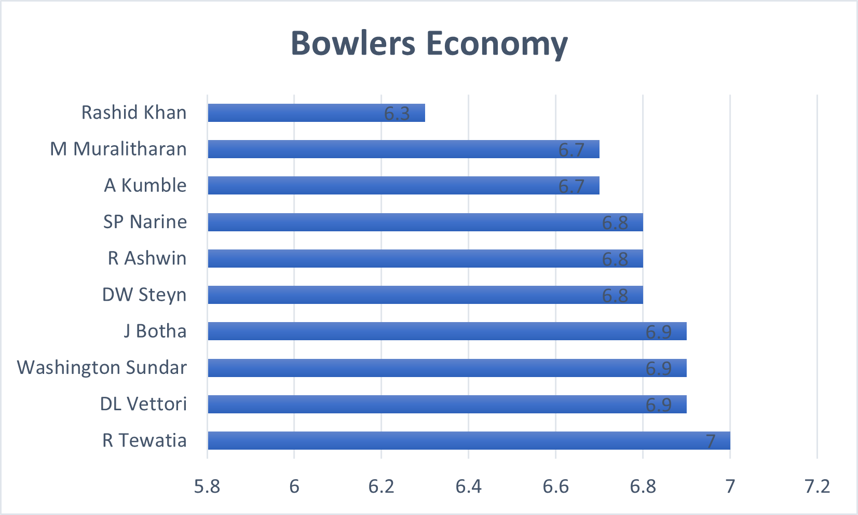
TOP BOWLERS

Slide 12
ALL ROUNDERS
AD RUSSEL | SP NARINE | HH PANDYA

Slide 13
TOP PLAYERS
Batsman | Strike Rate
AD Russell | 172
SP Narine | 155.7
HH Pandya | 150.4
V Sehwag | 148.8
GJ Maxwell | 148.6
AB de Villiers | 148.6
RR Pant | 146.8
JC Buttler | 144.8
KA Pollard | 143.5
CH Gayle | 142.8
Batsman | Player Average
Iqbal Abdulla | 88
KL Rahul | 42.7
AB de Villiers | 42.5
DA Warner | 41.7
JP Duminy | 41.4
CH Gayle | 41.1
ML Hayden | 41
LMP Simmons | 40
KS Williamson | 39.5
OA Shah | 38.9
Bowler | Strike_rate
K Rabada | 12.7
DE Bollinger | 14
AJ Tye | 14.3
MA Starc | 15.7
SL Malinga | 15.8
Imran Tahir | 15.8
DJ Bravo | 16.3
A Nehra | 16.3
S Aravind | 16.4
KK Cooper | 16.7
Bowler | Economy
R Tewatia | 7
DL Vettori | 6.9
Washington Sundar | 6.9
J Botha | 6.9
DW Steyn | 6.8
R Ashwin | 6.8
SP Narine | 6.8
A Kumble | 6.7
M Muralitharan | 6.7
Rashid Khan | 6.3
All Rounder | Batting SR | Bowling SR
AD Russell | 182.3 | 17.7
SP Narine | 164.3 | 19.7
HH Pandya | 159.3 | 20.3
Batsman | Boundary Percentage
SP Narine | 81.20%
AD Russell | 78.70%
CH Gayle | 76.10%
CR Brathwaite | 75.10%
ST Jayasuriya | 74.20%
BCJ Cutting | 73.10%
MJ McClenaghan | 72.90%
AC Gilchrist | 72.90%
MS Gony | 72.70%
KK Cooper | 72.40%

Slide 14
Criteria for Wicketkeeper Selection:
1. Experience Requirement:
Candidates must demonstrate a proven track record, having participated in more than two IPL seasons.
2. Batting Strike Rate:
We prioritize players who can bat dynamically and have a minimum strike rate of 125."
3. Bowling Economy Rate:
Candidates are expected to exhibit bowling efficiency, maintaining an economy rate below 10.
4. Fielding Proficiency:
The ability to contribute to fielding excellence is essential, underscoring the importance of a strong fielding rate.

Slide 15
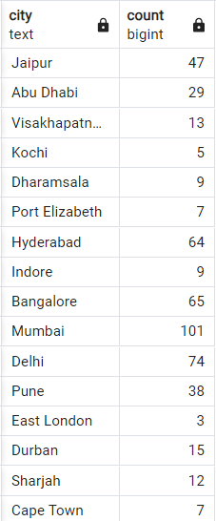
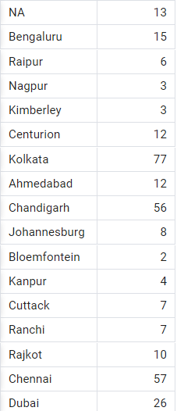
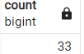
Additional Questions
1. Count of cities that have hosted an IPL match.
select city, count(city) from ipl_matches group by city;
select count(distinct city) from ipl_matches;

Slide 16
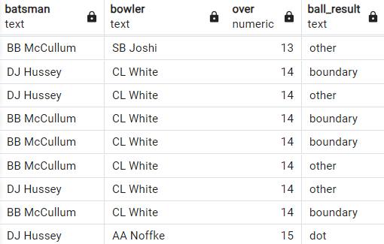
Additional Questions
2. Create table deliveries_v02 with all the columns of the table ‘deliveries’ and an additional column ball_result containing values boundary, dot or other depending on the total_run.
create table deliveries_v02 as ( select *, case when total_runs>=4 then 'boundary' when total_runs=0 then 'dot' else 'other' end ball_result
from ipl_ball);
select batsman, bowler, over, ball_result from deliveries_v02;

Slide 17
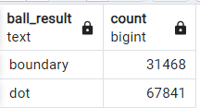
Additional Questions
3. Write a query to fetch the total number of boundaries and dot balls from the deliveries_v02 table.
select ball_result,count(ball_result) from deliveries_v02 where ball_result='boundary' or ball_result='dot' group by ball_result

Slide 18
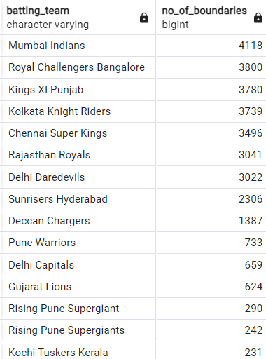
Additional Questions
4. Write query to fetch the total number of boundaries scored by each team from the deliveries_v02 table and order it in descending order of the number of boundaries scored.
select batting_team,count(ball_result) as no_of_boundaries from deliveries_v02 where ball_result='boundary' group by batting_team order by no_of_boundaries desc;

Slide 19
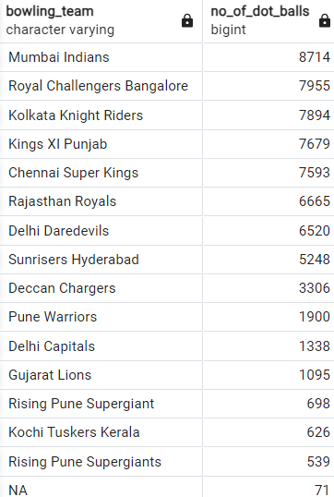
Additional Questions
5. Write a query to fetch the total number of dot balls bowled by each team and order it in descending order of the total number of dot balls bowled.
select bowling_team,count(ball_result) as no_of_dot_balls from deliveries_v02 where ball_result='dot' group by bowling_team order by no_of_dot_balls desc;

Slide 20
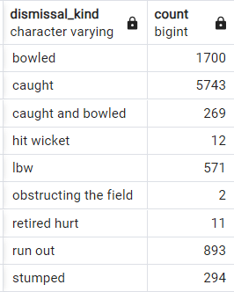
Additional Questions
6. Write a query to fetch the total number of dismissals by dismissal kinds where dismissal kind is not NA
select dismissal_kind,count(dismissal_kind) from deliveries_v02 where not dismissal_kind='NA' group by dismissal_kind

Slide 21
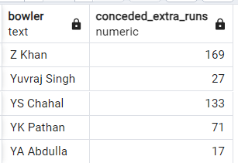
Additional Questions
7. Write a query to get the top 5 bowlers who conceded maximum extra runs from the deliveries table.
select bowler,sum(extra_runs) as conceded_extra_runs from deliveries_v02 group by bowler order by bowler desc limit 5;

Slide 22
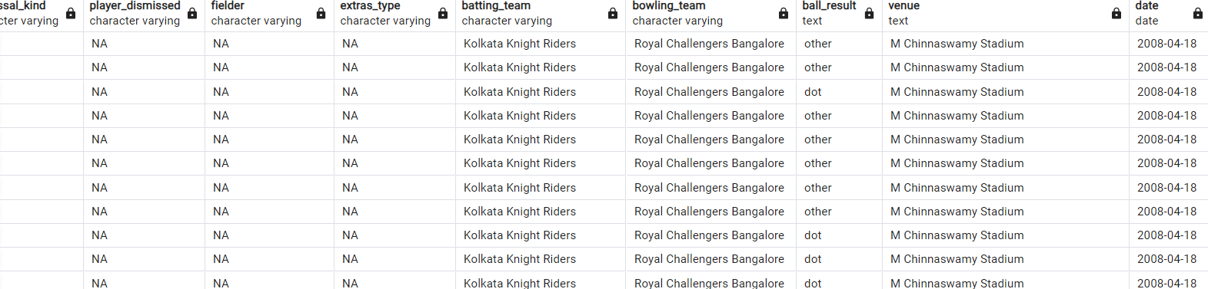
Additional Questions
8. Write a query to create a table named deliveries_v03 with all the columns of deliveries_v02 table and two additional column (named venue and match_date) of venue and date from table matches.
create table deliveries_v03 as(select a.* ,b.venue,b.date from deliveries_v02 as a full join ipl_matches as b on a.id=b.id);

Slide 23
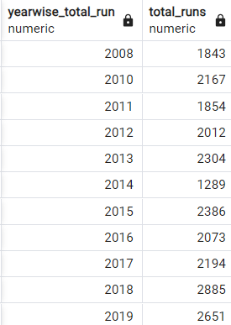
Additional Questions
9. Write a query to fetch the total runs scored for each venue and order it in the descending order of total runs scored.
select distinct extract(year from date) as yearwise_total_run,sum(total_runs) as total_runs
from deliveries_v03 where venue='Eden Gardens' group by yearwise_total_run;

Slide 24

THANK YOU!

